Slide 1
Technical Requirements - delete slide when complete -
The technical requirements for Project 1 are as follows.
[ ] Use Pandas to clean and format your data set(s)
[ ] Create a Jupyter Notebook describing the data exploration and cleanup process
[ ] Create a Jupyter Notebook illustrating the final data analysis
[ ] Use Matplotlib to create a total of 6-8 visualizations of your data (ideally, at least 2 per "question" you ask of your data)
[ ] Save PNG images of your visualizations to distribute to the class and instructional team, and for inclusion in your presentation
[ ] Optionally, use at least one API, if you can find an API with data pertinent to your primary research questions
[ ] Create a write-up summarizing your major findings. This should include a heading for each "question" you asked of your data, and under each heading, a short description of what you found and any relevant plots.
Notes:
Delete slide when presentation is complete. Guidelines page…
Copyright
Coding Boot Camp © 2017. All Rights Reserved.

Slide 2
Presentation Requirements - delete slide when complete -
The presentation requirements for Project 1 are as follows. Your presentation must:
[ ] Be at least 8-10 min. long
[ ] Describe the core message or hypothesis for your project.
[ ] Describe the questions you and your group found interesting, and what motivated you to answer them
[ ] Summarize where and how you found the data you used to answer these questions
[ ] Describe the data exploration and cleanup process (accompanied by your Jupyter Notebook)
[ ] Describe the analysis process (accompanied by your Jupyter Notebook)
[ ] Summarize your conclusions. This should include a numerical summary (i.e., what data did your analysis yield), as well as visualizations of that summary (plots of the final analysis data)
[ ] Discuss the implications of your findings. This is where you get to have an open-ended discussion about what your findings "mean".
[ ] Tell a good story! Storytelling through data analysis is no different than in literature. Find your narrative and use your analysis and visualization skills to highlight conflict and resolution in your data.
Notes:
Delete slide when presentation is complete. Guidelines page…
Copyright
Coding Boot Camp © 2017. All Rights Reserved.

Slide 3
Presentation Guidelines - delete slide when complete -
You are free to structure your presentations to your liking, but students tend to have success with the following format.
Title Slide
Include the name of the Project and Group Members
Motivation & Summary Slide
Define the core message or hypothesis of your project.
Describe the questions you asked, and why you asked them
Describe whether you were able to answer these questions to your satisfaction, and briefly summarize your findings
Questions & Data
Elaborate on the questions you asked, describing what kinds of data you needed to answer them, and where you found it
Data Cleanup & Exploration
Describe the exploration and cleanup process
Discuss insights you had while exploring the data that you didn't anticipate
Discuss any problems that arose after exploring the data, and how you resolved them
Present and discuss interesting figures developed during exploration, ideally with the help of Jupyter Notebook
Data Analysis
Discuss the steps you took to analyze the data and answer each question you asked in your proposal
Present and discuss interesting figures developed during analysis, ideally with the help of Jupyter Notebook
Discussion
Discuss your findings. Did you find what you expected to find? If not, why not? What inferences or general conclusions can you draw from your analysis?
Post Mortem
Discuss any difficulties that arose, and how you dealt with them
Discuss any additional questions that came up, but which you didn't have time to answer:
What would you research next, if you had two more weeks?
Questions
Open-floor Q&A with the audience
Notes:
Delete slide when presentation is complete. Guidelines page…
Copyright
Coding Boot Camp © 2017. All Rights Reserved.

Slide 4
Notes:
Blank cover page

Slide 5

Notes:
Image file

Slide 6
MINNESOTA COVID-19
Group 6
Philip Hill
Ian Mac Moore
Rob Gauer
Notes:
Title page and group members

Slide 7
Motivation & Thesis
We are concerned about the current state of the global pandemic and seek to better understand what’s being reported and trends, especially in Minnesota.
We asked whether testing necessarily increases number of positive cases, and how Minnesota compares to the rest of country?
We learned that for its population, the number of total confirmed cases in Minnesota is comparatively low, but average in total number. Testing and positive cases seems to track but were unable to draw any strong correlation.
Notes:
Define the core message or hypothesis of your project.
Describe the questions you asked, and why you asked them
Describe whether you were able to answer these questions to your satisfaction, and briefly summarize your findings

Slide 8
Questions & Data
We analyzed the impact that the COVID-19 pandemic has had on the Minnesota relative to overall testing, confirmed cases, hospitalizations and death rates by comparing
1) Impact Nationally.
2) Impact on Minnesota vs. Colorado and Michigan.
4) Impact on Minneapolis/St. Paul MN. vs. Detroit MI.
Notes:
Elaborate on the questions you asked, describing what kinds of data you needed to answer them, and where you found it

Slide 9

Questions & Data
Needed accurate, current, and ideally API accessible data on COVID-19
Led to covidtracking.com
Further didn’t know what State or cities to compare with, but knew we wanted to base on population
The de facto source for population data is the US Census
The city comparison caused a wrinkle because COVID-19 data was available only to the county level
Used county Census data and used that population size as proxy for “metro area”
Ended up with more analysis at State level because of available data.
Notes:
Elaborate on the questions you asked, describing what kinds of data you needed to answer them, and where you found it

Slide 10
Data cleanup & exploration
Phil did the initial heavy lift of composing API calls to grab the data we needed and generate CSVs used in analysis, then we split up so we each looked at a different level of comparison.
The counties as metro area proxy was tricky because the county data available was less thorough than what we had for State and National
Sorted Census data and compared MN values to determine comparisons
It wasn’t clear until we had the data in front of us that bar charts for the comparisons would be best
The line charts showing positive cases following testing also came late
Initially we thought Growth Factor could show directionality of trends, but it was too variable to be conclusive
Notes:
Describe the exploration and cleanup process
Discuss insights you had while exploring the data that you didn't anticipate
Discuss any problems that arose after exploring the data, and how you resolved them
Present and discuss interesting figures developed during exploration, ideally with the help of Jupyter Notebook

Slide 11
Data Analysis
Rob took States vs a National comparison
Phil did metro area comparison, as well some State level work
Ian Mac did population analysis to determine comparisons, and National level maps and line charts
Notes:
Discuss the steps you took to analyze the data and answer each question you asked in your proposal
Present and discuss interesting figures developed during analysis, ideally with the help of Jupyter Notebook

Slide 12
Impact nationally
Notes:
Discuss the steps you took to analyze the data and answer each question you asked in your proposal
Present and discuss interesting figures developed during analysis, ideally with the help of Jupyter Notebook

Slide 13
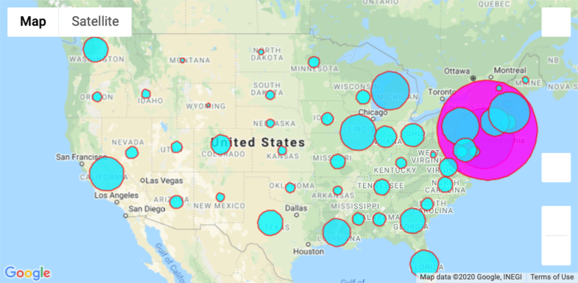
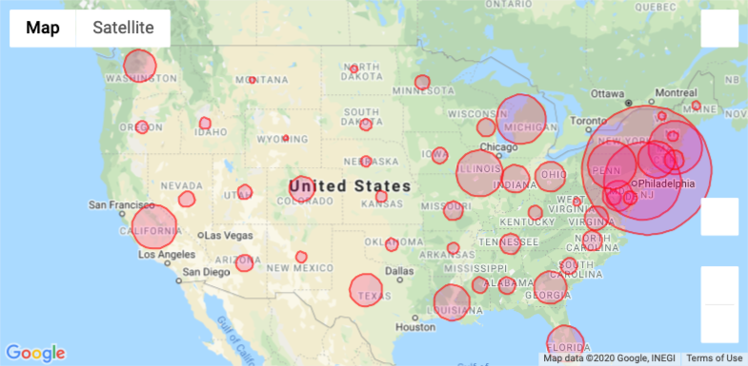
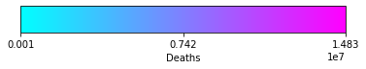
Impact nationally
-Circle size proportional to positive confirmed cases
-Initially no meaning to shade, then added Deaths data, scale in tens of thousands
-New York/New Jersey breaking the scale
Notes:
Discuss your findings.
Did you find what you expected to find? If not, why not?
What inferences or general conclusions can you draw from your analysis?

Slide 14
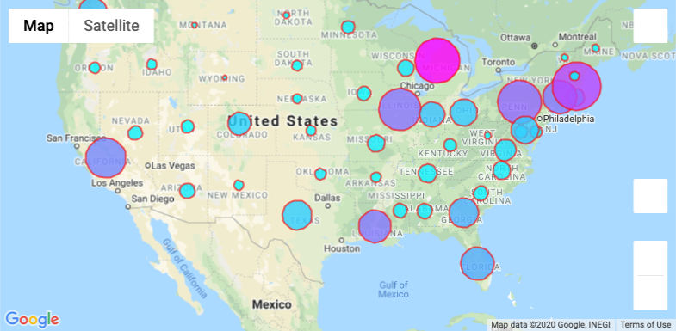
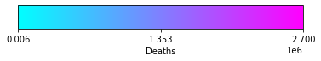
Impact nationally
-New York/New Jersey removed to get a better sense of the rest of the country
-Scale now in thousands
-MI (Detroit) clearly pops out, but so does MA (Boston)
-For the most part, death seem to scale with cases. Notable exception is MI
-CA, IL, and PA are very similar on both axes. WA, FL, and CT are similarly grouped, with CT having slightly
more deaths. CO, TX, IN, OH, and MD are next small grouping. LA has the most deaths of the Southern States.

Slide 15
Impact mn vs co vs nat’l avg
Notes:
Discuss the steps you took to analyze the data and answer each question you asked in your proposal
Present and discuss interesting figures developed during analysis, ideally with the help of Jupyter Notebook

Slide 16
Impact mn vs co
vs nat’l avg
How does the population of the Positive, Negative, Total Test Results, Hospitalizations, Recovered, and Deaths compare?
Overall Minnesota and Colorado are approximately the same for Total Test Results.
Colorado has a less Negatives and more Positives compared to Minnesota.
Minnesota compared to Michigan is nearly twice the number of individuals tested.

Slide 17
Impact mn vs co
vs nat’l avg
How does the population of the Hospitalizations, Recovered, and Deaths compare?
Michigan has nearly 3000 deaths compared to Colorado's 500 and Minnesota's less than 250.
Even with Michigan's high numbers of test results. Colorado and Minnesota have much less impact of the virus.

Slide 18
Impact mn vs co
vs nat’l avg
Here is a look at the data

Slide 19
Impact mn vs co
vs nat’l avg
Minnesota is twenty-second in population of all the 51 states.
Based on overall population the impact of total tests and deaths are very small. With New York, California, and Texas being the most populated.
Notes:
As a baseline, lets first look at how Minnesota compares Nationally for State Population, Total Test Results, and Deaths?

Slide 20
Impact mn vs co
vs nat’l avg
Nationally Minnesota is about average. New York, California, Florida, Texas, and New Jersey have the most infections based on numbers tested.
This chart shows those states that have completed more testing and show similar trends of high Negative infections. Which means one of two possible scenarios:
1. The virus is more isolated.
2. The virus contagious is not known due to being too early in the testing process.
3. Those tested today may get the virus tomorrow.
Notes:
How does Minnesota compare nationally related to Total Test Results, Positive, and Negative infections?

Slide 21
Impact mn vs co
vs nat’l avg
Minnesota barely measures related to Hospitalizations, Recovered, and Deaths (HRD). A possibility that we are very early in the spread of the virus or low in numbers based on other probabilities yet to be determined.
Higher number of HRD is occurring on the east coast of the United States. New York, Florida, Georgia, Massachusetts, Maryland, New Jersey have more Hospitalizations and Deaths.
Notes:
How does Minnesota compare nationally related to the number of Hospitalized, Recovered, and Deaths?

Slide 22
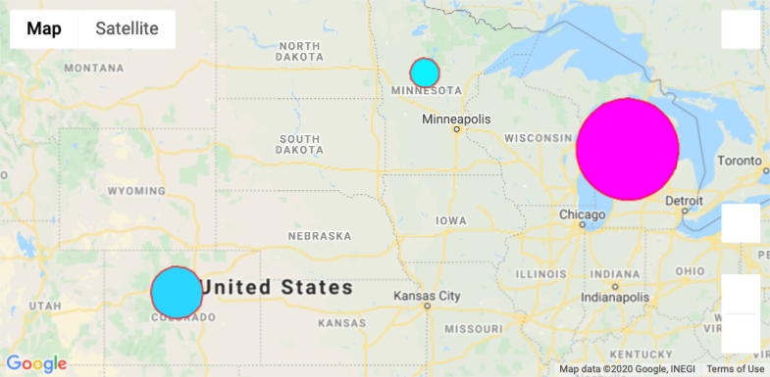
Impact mn vs co
vs nat’l avg
Zoomed in view of the map
Circle size proportional to positive cases
Deaths shaded in, scale in thousands
Notes:
How does Minnesota compare nationally related to the number of Hospitalized, Recovered, and Deaths?

Slide 23
Impact mn vs co
vs nat’l avg
Interval data since beginning of March on Testing, Positives, and Deaths
MN and MI appear to have Tests and Positives lines follow each other starting first week of April.
It's enough to warrant deeper study into whether this is to be expected or not.
Notes:
How does Minnesota compare nationally related to the number of Hospitalized, Recovered, and Deaths?

Slide 24
Impact msp vs detroit
Notes:
Discuss the steps you took to analyze the data and answer each question you asked in your proposal
Present and discuss interesting figures developed during analysis, ideally with the help of Jupyter Notebook

Slide 25
Both of these metropolitan areas were of comparable population size, thus deemed appropriate for impact analysis
Detroit had 11 times as may confirmed positive cases than Minneapolis since the beginning of 2020. (Detroit: 14,994, MSP: 1,367)
Detroit has 11 times as may currently active cases as Minneapolis has as of 4/24/2020. (Detroit: 13,598, MSP: 1,230)
Detroit has 32 times as may deaths as Minneapolis has as of 4/24/2020. (Detroit: 1,396, MSP: 137)
Impact msp vs detroit
Notes:
How does Minnesota compare nationally related to the number of Hospitalized, Recovered, and Deaths?

Slide 26
Discussion
Discuss your findings.
Did you find what you expected to find? If not, why not?
What inferences or general conclusions can you draw from your analysis?
Notes:
Discuss your findings.
Did you find what you expected to find? If not, why not?
What inferences or general conclusions can you draw from your analysis?

Slide 27
Post mortem
Notes:
Discuss any difficulties that arose, and how you dealt with them
Discuss any additional questions that came up, but which you didn't have time to answer: What would you research next, if you had two more weeks?

Slide 28
Post mortem
Could take interpretations of visuals and dig deeper into what seem to be groupings of States.
A next phase or attempt of charting could be to do a layer of counties and show similar gradient. Could also work on making chart interactive, with hover-over revealing data values.
Determine quantitative measure for "closeness".
Find automated way to bring in geographic area data.
Find data source for metro areas, instead of relying on county proxy.
Look at volatility closer. Could try to normalize or compress scale of tests to better see trends of positive cases and deaths.
Notes:
Discuss any difficulties that arose, and how you dealt with them
Discuss any additional questions that came up, but which you didn't have time to answer: What would you research next, if you had two more weeks?

Slide 29
Questions
Open-floor Q&A with the audience
Notes:
Open-floor Q&A with the audience
Copyright
Coding Boot Camp © 2017. All Rights Reserved.

Slide 30

[ WASH YOUR HANDS ]
Notes:
Image file

Slide 31
Notes:
Thank you.

